Slide 1
Dimensionality Reduction
Principal Component Analysis (PCA)
Singular Value Decomposition (SVD)
Factor Analysis (FA)

Slide 2
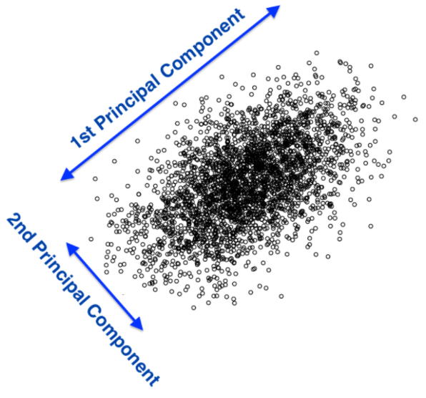
What Is PCA?
PCA is a technique that finds underlying variables (known as Principal components) that best differentiate your data points
Principal components are dimensions along which your data points are most spread out

Slide 3
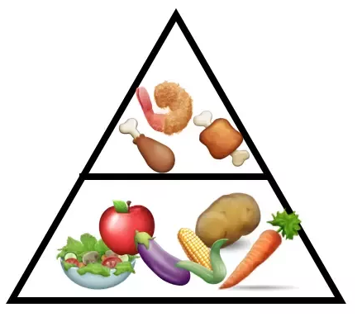
Principal Component Analysis (PCA)
Imagine you are a nutritionist trying to explore the nutrition content of food
You need to identify parameters to differentiate food items
Why is that helpful?
Visualization
Clustering
How to do that?
Source: https://algobeans.com/2016/06/15/principal-component-analysis-tutorial/

Slide 4
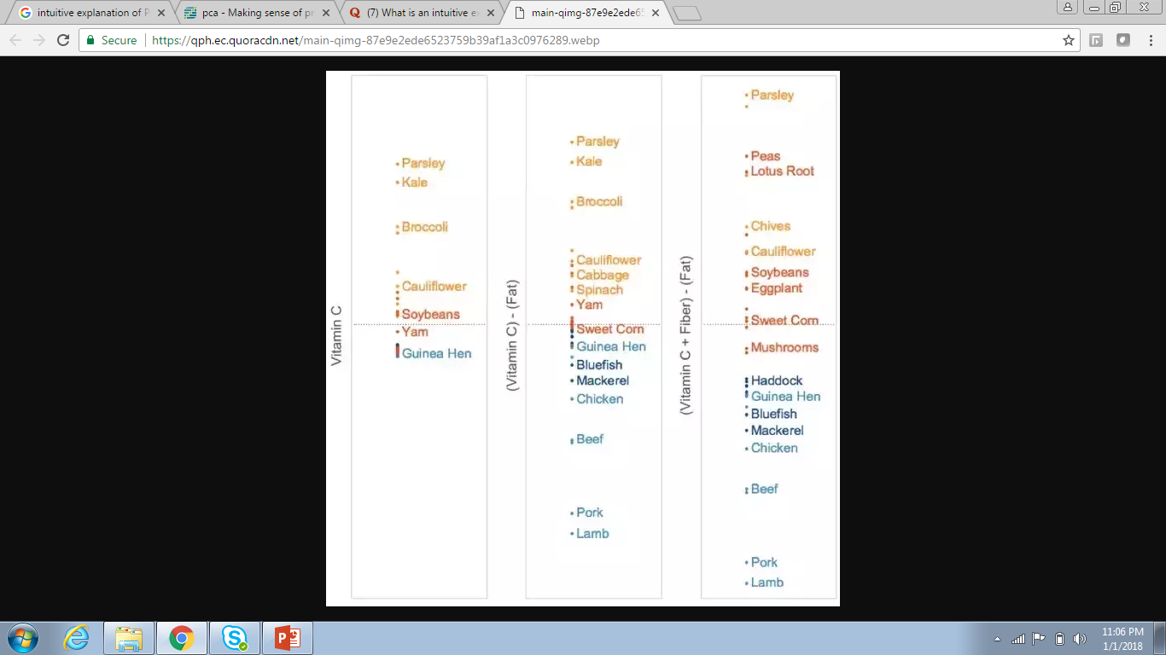
What are Principal Components?
A Principal component can be expressed by one or more existing variables
For example, we may use a single variable - vitamin C - to differentiate food items
Because vitamin C is present in vegetables but absent in meat, the resulting plot will differentiate vegetables from meat, but meat items will clumped together

Slide 5

What are Principal Components?
To spread the meat items out, we can use fat content in addition to vitamin C levels, since fat is present in meat but absent in vegetables
New combined variable - vitamin C minus fat. Combining the two variables helps to spread out both vegetable and meat items.

Slide 6

What are Principal Components?
The spread can be further improved by adding fiber, of which vegetable items have varying levels
This new variable - (vitamin C + fiber) minus fat - achieves the best data spread yet.

Slide 7
How are the Principal Components derived?
Using data from the United States Department of Agriculture, the nutritional content of a random sample of food items was analyzed
Four nutrition variables were analyzed: Vitamin C, Fiber, Fat and Protein
For fair comparison, food items were raw and measured by 100g.

Slide 8
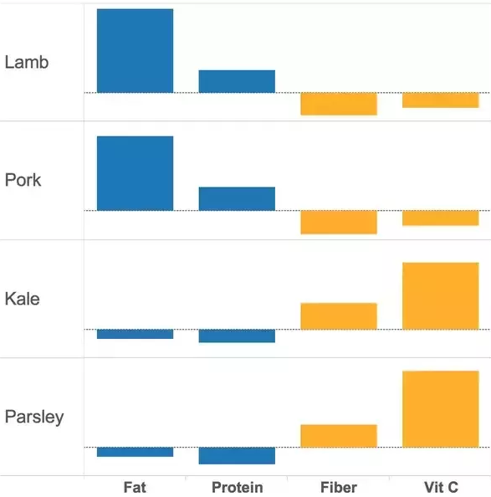
How are the Principal Components derived?
Among food items, the presence of certain nutrients appear correlated
Therefore, instead of analyzing all 4 nutrition variables, we can combine highly-correlated variables, leaving just 2 dimensions to consider.
This is the same strategy used in PCA - it examines correlations between variables to reduce the number of dimensions in the dataset

Slide 9
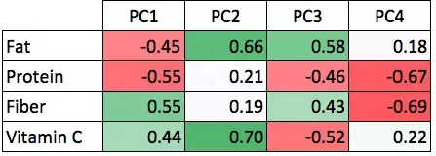
How are the Principal Components derived?
Applying PCA to this food dataset results in these Principal components
Numbers represent weights used in combining variables to derive Principal components
For example, to get the top Principal component (PC1) value for a particular food item, we add up the amount of Fiber and Vitamin C it contains, with slightly more emphasis on Fiber, and then from that we subtract the amount of Fat and Protein it contains, with Protein negated to a larger extent.

Slide 10
How are the Principal Components derived?
We observe that the top Principal component (PC1) summarizes our findings so far - it has paired fat with protein, and fiber with vitamin C
It also takes into account the inverse relationship between the pairs. Hence, PC1 likely serves to differentiate meat from vegetables
The second Principal component (PC2) is a combination of two unrelated nutrition variables - fat and vitamin C
It serves to further differentiate sub-categories within meat (using fat) and vegetables (using vitamin C).

Slide 11
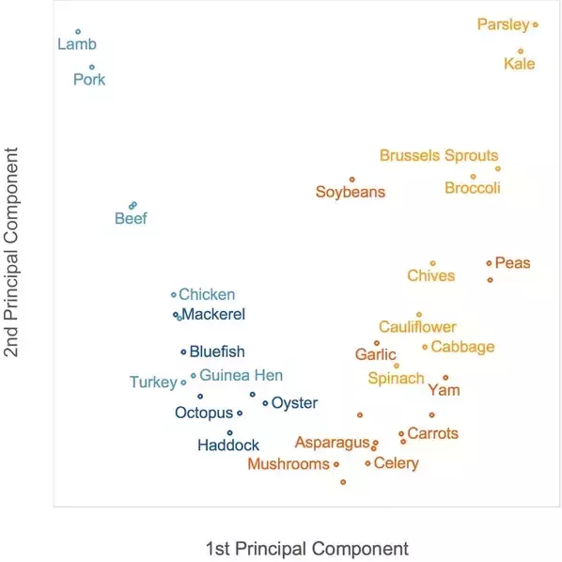
How are the Principal Components derived?
Using the top 2 Principal components to plot food items results in the best data spread thus far
Meat items (blue) have low PC1 values, and are thus concentrated on the left of the plot, on the opposite side from vegetable items (orange)
Among meats, seafood items (dark blue) have lower fat content, so they have lower PC2 values and are at the bottom of the plot. Several non-leafy vegetarian items (dark orange), having lower vitamin C content, also have lower PC2 values and appear at the bottom

Slide 12
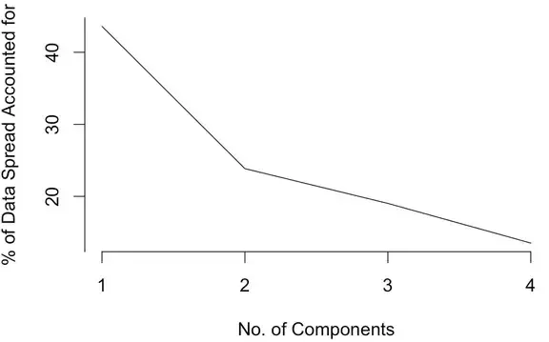
How do we choose the number of components?
Scree Plot

Slide 13
Limitations of PCA
Interpreting Components
Orthogonal Components

Slide 14
Lets now understand what goes on behind the hood…
But before that, lets have a quick refresher on linear algebra…
Standard Deviation
Covariance
Eigenvectors
Eigenvalues

Slide 15
Getting Back to PCA
So far we learned that PCA is a way of identifying patterns in data, and expressing the data in such a way as to highlight their similarities and differences
Especially useful for large dimensional data
Lets see the steps required to perform PCA…

Slide 16
So Lets Summarize This…
Imagine a big family dinner, where everybody starts asking you about PCA. First you explain it to your great-grandmother; then to you grandmother; then to your mother; then to your spouse; finally, to your daughter (who is a mathematician). Each time the next person is less of a layman. Here is how the conversation might go
https://stats.stackexchange.com/questions/2691/making-sense-of-principal-component-analysis-eigenvectors-eigenvalues/140579#140579?newreg=c5d8b5320100496ba13720f65f8570db

Slide 17
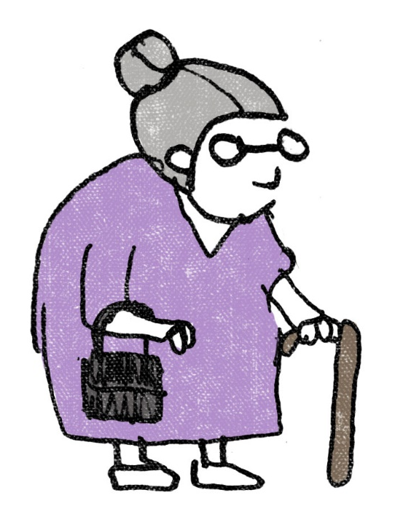

Great-grandmother
I heard you are studying "Pee-See-Ay". I wonder what that is...

Slide 18
Great-grandmother
You: Ah, it's just a method of summarizing some data. Look, we have some wine bottles standing here on the table. We can describe each wine by its color, by how strong it is, by how old it is, and so on. We can compose a whole list of different characteristics of each wine in our cellar. But many of them will measure related properties and so will be redundant. If so, we should be able to summarize each wine with less characteristics! This is what PCA does.

Slide 19

Grandmother
This is interesting! So this PCA thing checks what characteristics are redundant and discards them?

Slide 20
Grandmother
You: Excellent question, granny! No, PCA is not selecting some characteristics and discarding the others. Instead, it constructs some new characteristics that turn out to summarize our list of wines well. Of course these new characteristics are constructed using the old ones; for example, a new characteristic might be computed as wine age minus wine acidity level or some other combination like that (we call them linear combinations).
In fact, PCA finds the best possible characteristics, the ones that summarize the list of wines as well as possible (among all conceivable linear combinations). This is why it is so useful.

Slide 21

Mother
Hmmm, this certainly sounds good, but I am not sure I understand. What do you actually mean when you say that these new PCA characteristics "summarize" the list of wines?

Slide 22
Mother
You: I guess I can give two different answers to this question. First answer is that you are looking for some wine properties (characteristics) that strongly differ across wines. Indeed, imagine that you come up with a property that is the same for most of the wines. This would not be very useful, wouldn't it? Wines are very different, but your new property makes them all look the same! This would certainly be a bad summary. Instead, PCA looks for properties that show as much variation across wines as possible.
The second answer is that you look for the properties that would allow you to predict, or "reconstruct", the original wine characteristics. Again, imagine that you come up with a property that has no relation to the original characteristics; if you use only this new property, there is no way you could reconstruct the original ones! This, again, would be a bad summary. So PCA looks for properties that allow to reconstruct the original characteristics as well as possible.
Surprisingly, it turns out that these two aims are equivalent and so PCA can kill two birds with one stone.

Slide 23

Spouse
But darling, these two "goals" of PCA sound so different! Why would they be equivalent?

Slide 24
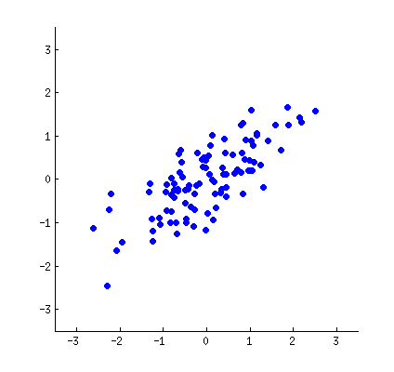
Spouse
Hmmm. Perhaps I should make a little drawing (takes a napkin and starts scribbling). Let us pick two wine characteristics, perhaps wine darkness and alcohol content -- I don't know if they are correlated, but let's imagine that they are. Here is how a scatter plot of different wines could look like:

Slide 25
Spouse
Each dot in this "wine cloud" shows one particular wine. You see that the two properties x & y in this figure are correlated. A new property can be constructed by drawing a line through the center of this wine cloud and projecting all points onto this line. This new property will be given by a linear combination w1x + w2y, where each line corresponds to some particular values of w1 & w2

Slide 26

Spouse
Now look here very carefully -- here is how these projections look like for different lines (red dots are projections of the blue dots):

Slide 27
Spouse
As I said before, PCA will find the "best" line according to two different criteria of what is the "best". First, the variation of values along this line should be maximal. Pay attention to how the "spread" (we call it "variance") of the red dots changes while the line rotates; can you see when it reaches maximum?

Slide 28
Spouse
Second, if we reconstruct the original two characteristics (position of a blue dot) from the new one (position of a red dot), the reconstruction error will be given by the length of the connecting red line. Observe how the length of these red lines changes while the line rotates; can you see when the total length reaches minimum?

Slide 29

Daughter
Very nice, papa! I heard that PCA is somehow related to eigenvectors and eigenvalues; where are they on this picture?

Slide 30
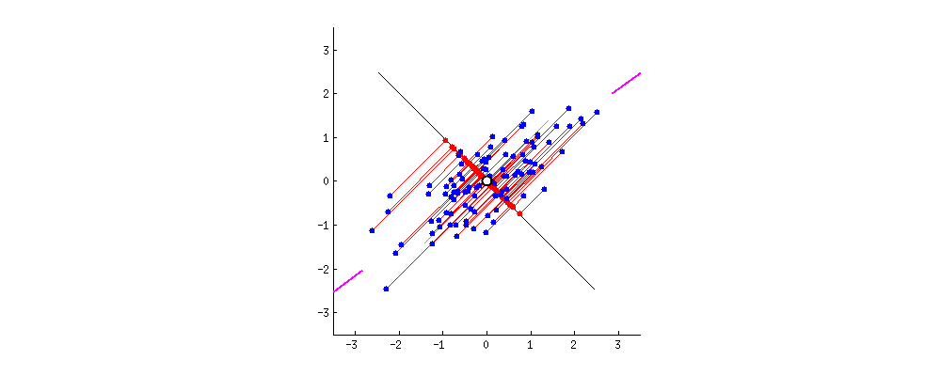
Daughter
You can imagine that the black line is a solid rod and each red line is a spring. The energy of the spring is proportional to its squared length (this is known in physics as the Hooke's law), so the rod will orient itself such as to minimize the sum of these squared distances. I made a simulation of how it will look like, in the presence of some viscous friction:

Slide 31
Daughter
Regarding eigenvectors and eigenvalues. You know what a covariance matrix is; in my example it is a 2X2 matrix given by:
(1.07 0.63
0.63 0.64)
What this means is that the variance of the x variable is 1.07, the variance of the y variable is 0.64, and the covariance between them is 0.63. As it is a square symmetric matrix, it can be diagonalized by choosing a new orthogonal coordinate system, given by its eigenvectors (incidentally, this is called spectral theorem); corresponding eigenvalues will then be located on the diagonal. In this new coordinate system, the covariance matrix is diagonal and looks like that:
(1.52 0
0 0.19)

Slide 32
Daughter
the covariance matrix is diagonal and looks like that:
(1.52 0
0 0.19)
meaning that the correlation between points is now zero. It becomes clear that the variance of any projection will be given by a weighted average of the eigenvalues (I am only sketching the intuition here). Consequently, the maximum possible variance (1.52) will be achieved if we simply take the projection on the first coordinate axis. It follows that the direction of the first principal component is given by the first eigenvector of the covariance matrix

Slide 33
Daughter
You can see this on the rotating figure as well: there is a gray line there orthogonal to the black one; together they form a rotating coordinate frame. Try to notice when the blue dots become uncorrelated in this rotating frame. The answer, again, is that it happens precisely when the black line points at the magenta ticks. Now I can tell you how I found them: they mark the direction of the first eigenvector of the covariance matrix, which in this case is equal to (0.81, 0.58)

Slide 34
Singular Value Decomposition (SVD)

Slide 35
What is SVD?
Another dimensionality reduction technique
Method for transforming correlated variables into a set of uncorrelated ones that better expose the various relationships among original data items
Method for identifying and ordering the dimensions along which data points exhibit the most variation
Method of approximating the original data points using fewer dimensions

Slide 36
So how does SVD works?

Slide 37
Lets understand this through an R example…

Slide 38

Another example to understand SVD…
The image is made of 400 unique row vectors

Slide 39
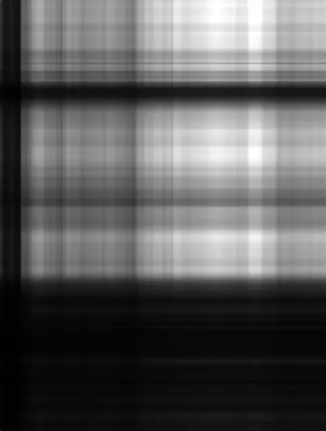
Another example to understand SVD…
What happens if I take the first singular vector?

Slide 40
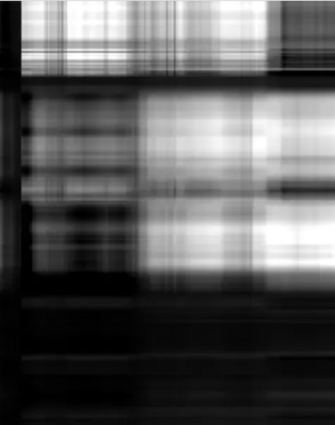
Another example to understand SVD…
What happens if I take the first two singular vectors?

Slide 41
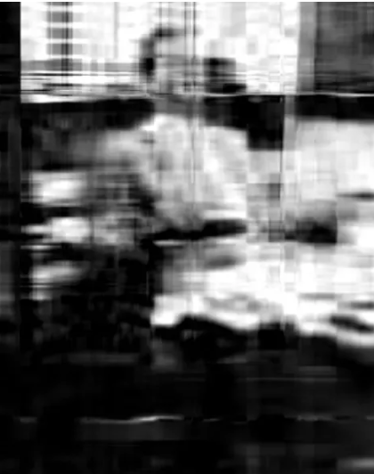
Another example to understand SVD…
What happens if I take the first 10 singular vectors?

Slide 42

Another example to understand SVD…
What happens if I take the first 50 singular vectors?
Using 50 unique values we get a decent representation of what 400 unique values look like…

Slide 43
Factor Analysis

Slide 44
What Is Factor Analysis?
Factor analysis is a method for investigating whether a number of variables of interest Y1, Y2, …, Yl, are linearly related to a smaller number of unobservable factors F1, F2, …, Fk
Lets understand this through an example…

Slide 45
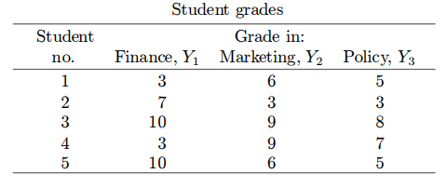
Factor Analysis – An Example
Students entering a certain MBA program must take three required courses in Finance, Marketing and Business Policy.
Let Y1, Y2, and Y3, respectively, represent a student's grades in these courses.

Slide 46
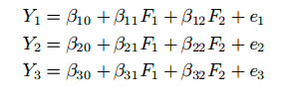
Factor Analysis – An Example
Lets assume that the grades are functions of two underlying factors – F1 and F2, loosely described as quantitative ability and verbal ability
Lets assume that each variable Y is linearly related to the two factors:
The error terms e1, e2, and e3, serve to indicate that the hypothesized relationships are not exact
Notes:
The parameters Bij are referred to as loadings. For example, B12 is called the loading of variable Y1 on factor F2

Slide 47
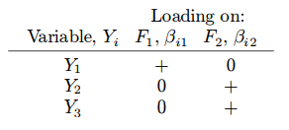
Factor Analysis – An Example
In this MBA program, Finance is highly quantitative, while Marketing and Policy have a strong qualitative orientation.
Quantitative skills should help a student in Finance, but not in Marketing or Policy. Verbal skills should be helpful in marketing or policy but not in finance.
In other words, it is expected that the loadings have roughly the following structure:
Notes:
The grade in the finance course is expected to be positively related to quantitative ability but unrelated to verbal ability; the grades in marketing and policy, on the other hand, are expected to be positively related to verbal ability but unrelated to quantitative ability

Slide 48
Factor Analysis – An Example
Factor analysis is based on two assumptions:
Assumption 1: The error terms ei are independent of one another, and such that E(ei) = 0 and Var(ei) = σ²
Assumption 2: The unobservable factors Fj are independent of one another and of the error terms, and are such that E(Fj ) = 0 and Var(Fj ) = 1
In the context of the present example, this means in part that there is no relationship between quantitative and verbal ability.
In more advanced models of factor analysis, the condition that the factors are independent of one another can be relaxed

Slide 49
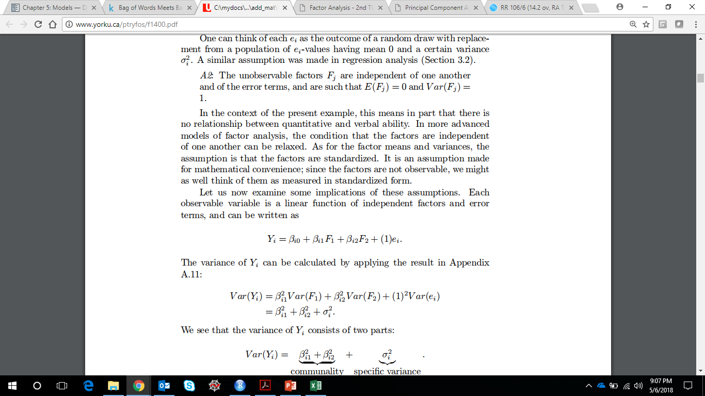
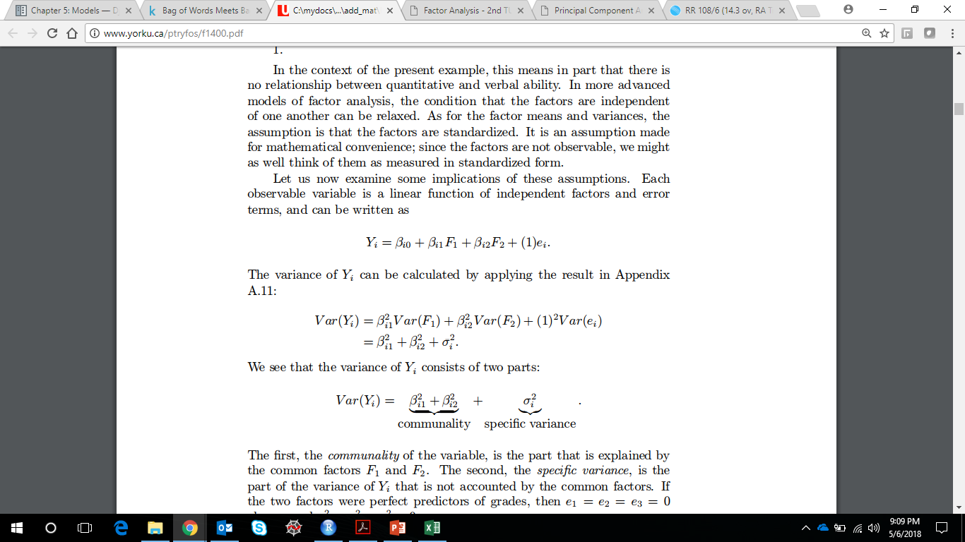

Factor Analysis – An Example
Lets examine the implications of these assumptions
Lets re-write the previous equation as:
Variance of Y can be written as:
So, the variance of Y consists of two parts:
Notes:
The first, the communality of the variable, is the part that is explained by the common factors F1 and F2. The second, the specific variance, is the part of the variance of Yi that is not accounted by the common factors.

Slide 50
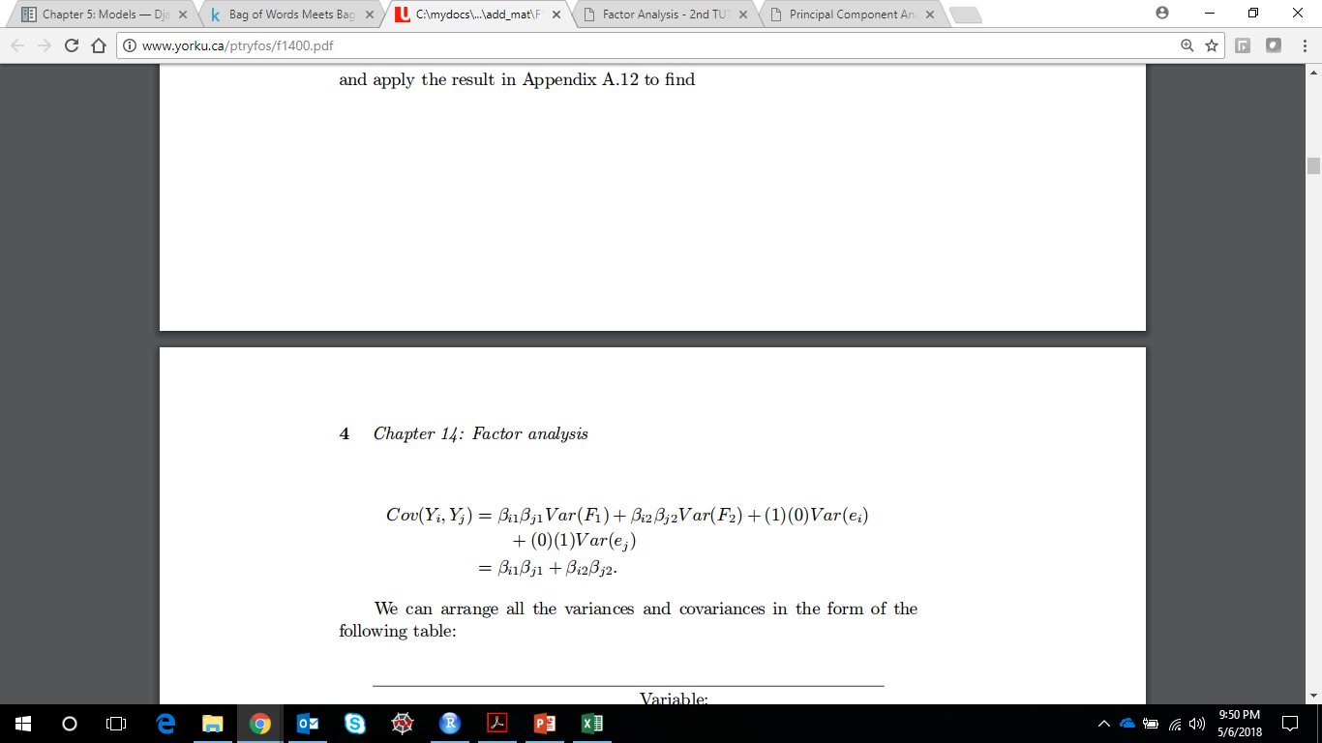
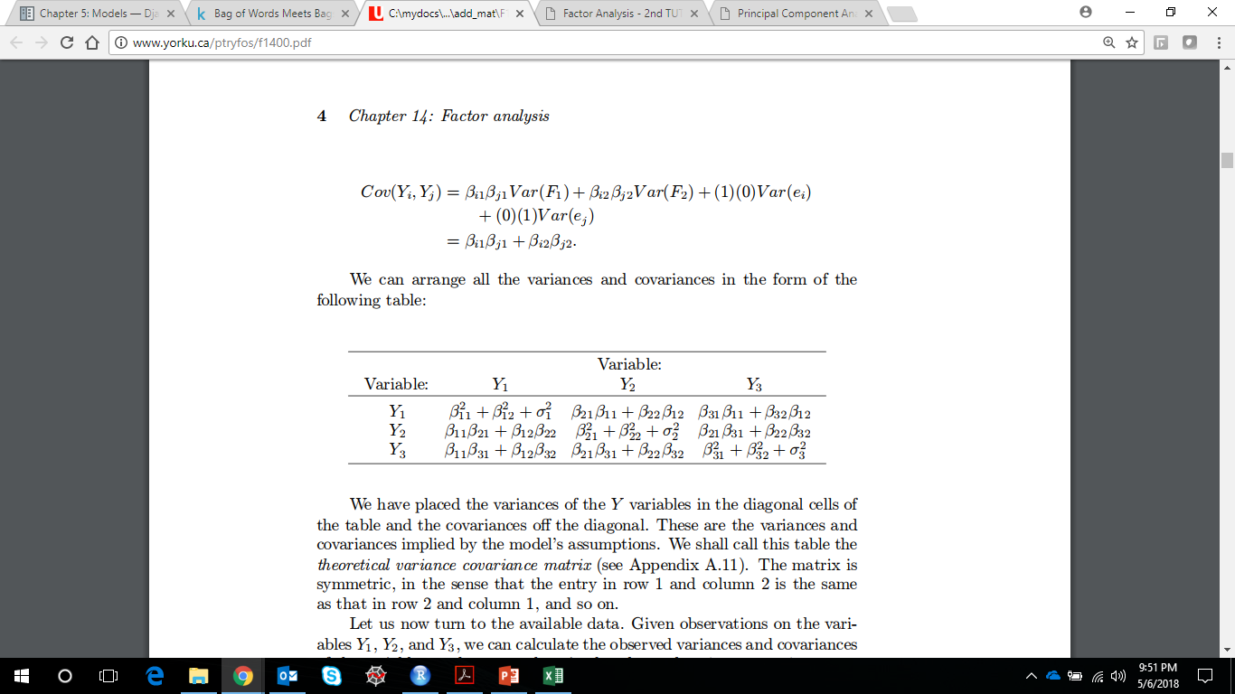
Factor Analysis – An Example
Similarly, the covariance of any two observable variables, Yi and Yj:
Lets arrange all the variances and covariance in the form of a table:
Notes:
These are the variances and covariances implied by the model's assumptions. We shall call this table the theoretical variance covariance matrix

Slide 51
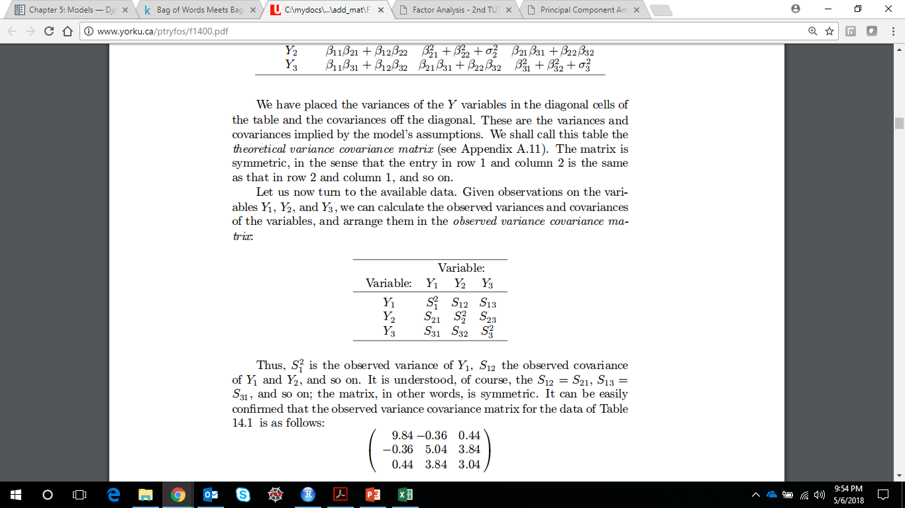
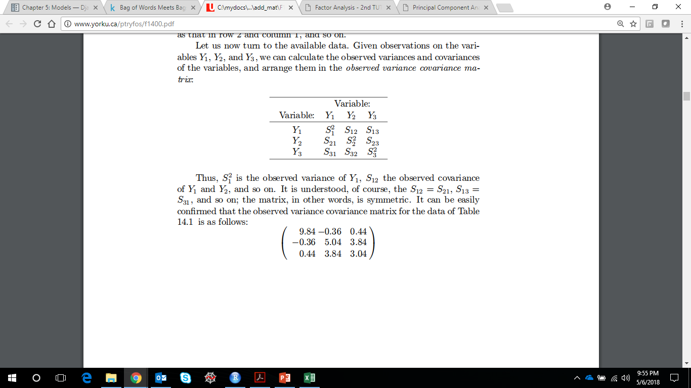
Factor Analysis – An Example
Let us now turn to the available data. Given observations on the variables Y1, Y2, and Y3, we can calculate the observed variances and covariance of the variables, and arrange them in the observed variance covariance matrix:
Notes:
Thus, S21 is the observed variance of Y1 , S12 the observed covariance of Y1 and Y2, and so on. It can be easily confirmed that the observed variance covariance matrix for the data is as shown as in the adjacent table.

Slide 52
Factor Analysis – An Example
On the one hand, we have the observed variances and covariances of the variables
On the other, the variances and covariances implied by the factor model
If the model's assumptions are true, we should be able to estimate the loadings βij so that the resulting estimates of the theoretical variances and covariances are close to the observed ones
We shall soon see how these estimates can be obtained, but first let us examine an important feature of the factor model

Slide 53
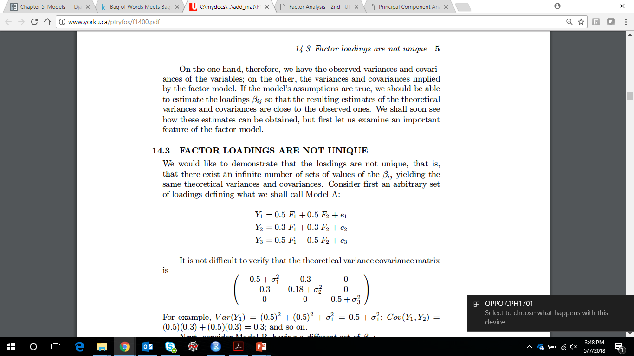
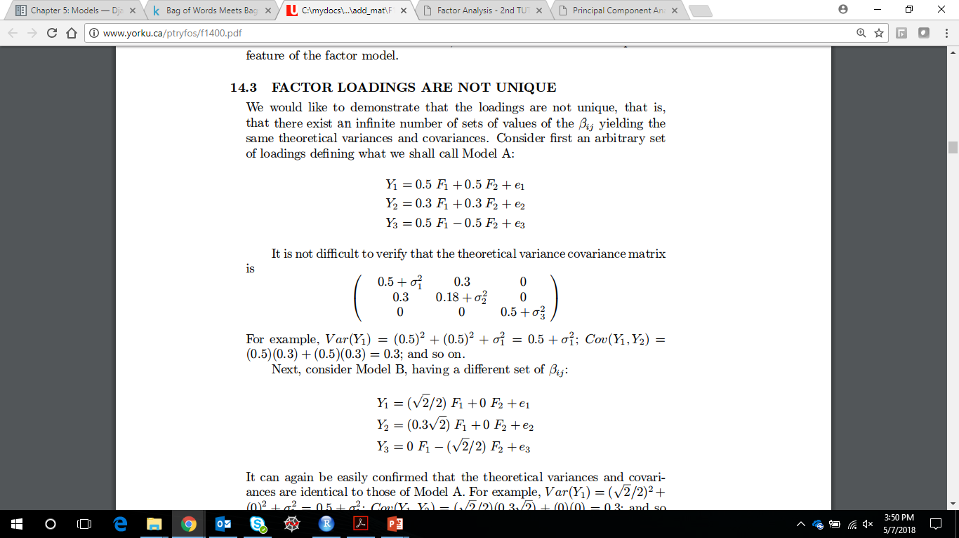
Factor Loadings Are Not Unique
There exist an infinite number of sets of values of the βij yielding the same theoretical variances and covariances
Lets consider an example…
Consider first an arbitrary set of loadings (lets call this Model A)
The theoretical variance covariance matrix is

Slide 54
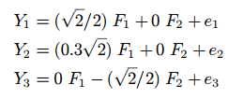
Factor Loadings Are Not Unique
Next, lets consider another model B, having different set of βij
You can verify that the theoretical variances and covariances matrix for model B is the same as model A
Lets understand this graphically. Lets first plot the coefficients of F1 and F2 from model A. The coordinates to be plotted are (0.5,0.5), (0.3,0.3) and (0.5, -0.5)

Slide 55
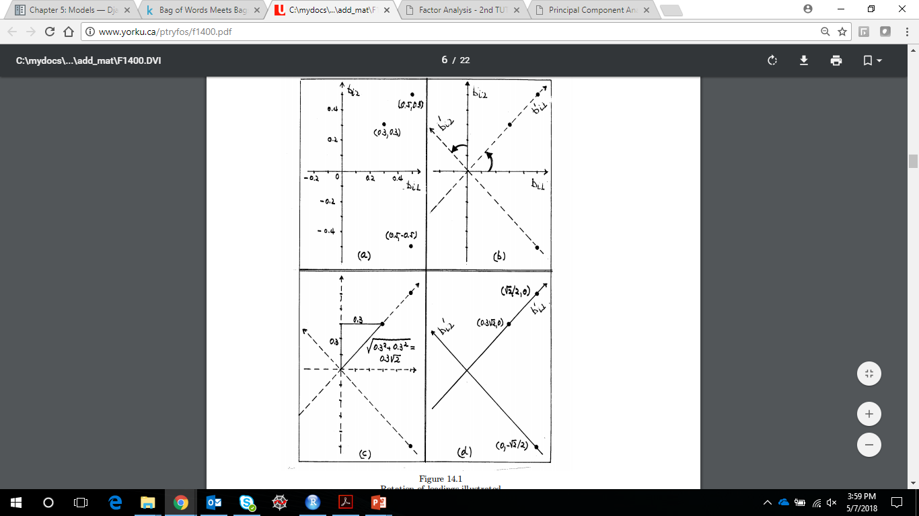
Factor Loadings Are Not Unique
Next, imagine rotating the coordinate axes anticlockwise by 45º as shown to arrive at the new coordinate axes indicated by the dotted lines
Lets calculate the coordinates of the three points wrt to the next coordinate axis. What do we observe?
We see that the loadings of Model B are the result of applying rotation to the loadings of Model A

Slide 56
Factor Loadings Are Not Unique
It can be shown that any other rotation of the original loadings will produce a new set of loadings with the same theoretical variances and covariances as those of the original model
The number of such rotations is, of course, infinite large
Rather than being a disadvantage, this property of the factor model is put to good use in practice

Slide 57
Factor Loadings Are Not Unique
Recall that there are usually some prior expectations concerning the loadings.
In particular, it is expected that some loadings will be close to zero, while others will be positive or negative and substantially different from zero.
For this reason, factor analysis usually proceeds in two stages.
In the first, one set of loadings βij is calculated which yields theoretical variances and covariances that fit the observed ones as closely as possible according to a certain criterion.
These loadings, however, may not agree with the prior expectations, or may not lend themselves to a reasonable interpretation.

Slide 58
Factor Loadings Are Not Unique
Thus, in the second stage, the first loadings are rotated in an effort to arrive at another set that fit equally well the observed variances and covariances, but are more consistent with prior expectations or more easily interpreted

Slide 59
How to find the factor loadings?
Principal Component Method (not to be confused with PCA!!!)
Principal Axis Method
Maximum Likelihood Method
While all these methods work similarly, lets understand more about the Principal Component Method
This method seeks values of the loadings that bring the estimate of the total communality as close as possible to the total of the observed variances. The covariances are ignored.
Notes:
The communality, as you might recall, is the part of the variance of the variable that is explained by the factors. The larger this part, the more successful the postulated factor model can be said to be in explaining the variable.

Slide 60
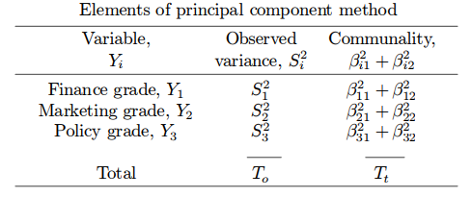
How to find the factor loadings?
The principal component method determines the values of the βij which make the total communality (Tt) approximate as closely as possible the sum of the observed variances of the variables (To)

Slide 61
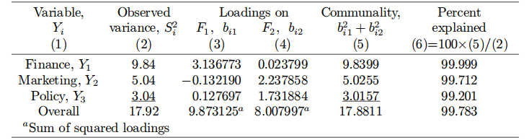
How to find the factor loadings?
Considering the initial values, we get the following output from the Principal Component Method
We see that the solution supports the expectations. The loadings on F1 are relatively large for Y1 but close to zero for Y2 and Y3; the loadings on F2 are close to zero for Y1 but relatively high for Y2 and Y3 . Thus, F1 could be interpreted as quantitative, and F2 as verbal, ability.
We also observe that the factor model explains nearly 100%, 99.7%, and 99.2% respectively of the observed variance of finance, marketing and policy grades. Overall, the two factors explain 99.78% of the sum of all observed variances.
Notes:
Values in (3) and (4) are obtained from Spectral decomposition of the sample covariance matrix

Slide 62
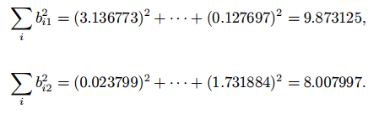
How to find the factor loadings?
The sum of squared loadings on F1 and F2 can be interpreted as their contribution in explaining the sum of the observed variances
Thus, F1 explains about 9.873/19.92 or 55.1%, and F2 about 44.7% of the sum of the observed variances

Slide 63
Factor Rotation
When the first factor solution does not reveal the hypothesized structure of the loadings, it is customary to apply rotation in an effort to find another set of loadings that fit the observations equally well but can be more easily interpreted.
As it is impossible to examine all such rotations, computer programs carry out rotations satisfying certain criteria.
There are two types of factor rotation: orthogonal & oblique rotation

Slide 64
Factor Rotation – Orthogonal Rotation
Orthogonal rotations constrain factors to be uncorrelated
Several types of orthogonal rotation exists – varimax, quartimax, etc.
Advantage of orthogonal rotation is its simplicity
Disadvantage lies in its assumption, which may not hold true when the underlying factors are correlated

Slide 65
Factor Rotation – Oblique Rotation
Oblique rotations permit correlations among factors, though the factors thus identified may not correlate
If factors do not correlate these rotations may produce solutions similar to orthogonal rotation
Several oblique rotation procedures are commonly used - direct oblimin rotation, direct quartimin rotation, promax rotation, and Harris-Kaiser orthoblique rotation
An advantage of oblique rotation is that it produces solutions with better simple structure because it allows factors to correlate, and produces estimates of correlations among factors

Slide 66
How to choose the number of Factors?
It is better to include too many factors (overfactoring) than too few factors (underfactoring)
Several procedures designed to determine the optimal number of factors to retain in EFA:
Kaiser's (1960) eigenvalue-greater-than-one rule (K1 or Kaiser criterion)
Cattell's (1966) scree plot
Revelle and Rocklin (1979) very simple structure
Model comparison techniques
Optimal Coordinate and Acceleration Factor
Velicer's Minimum Average Partial test (MAP)
Parallel analysis

Slide 67
So how is PCA different than FA?
In terms of a simple rule of thumb, I'd suggest that you:
Run factor analysis if you assume or wish to test a theoretical model of latent factors causing observed variables.
Run principal component analysis If you want to simply reduce your correlated observed variables to a smaller set of important independent composite variables

